Slide 1

KM Mini Drive: A Cloud-based file storage & sharing using AWS
Presentation by: KANMANI

Slide 2
Introduction
Google Drive is a cloud-based file storage service that allows users to store & access files from any device.
Why build KM Mini Drive? → For learning purposes and hands-on experience with cloud technologies.
Objective: Replicate Google Drive’s core features using AWS (EC2, S3, IAM, MariaDB).

Slide 3
Problem Statement
Need for secure, scalable file storage.
Importance of accessibility (anytime, anywhere).
Challenge: balancing simplicity with real-world cloud concepts.

Slide 4
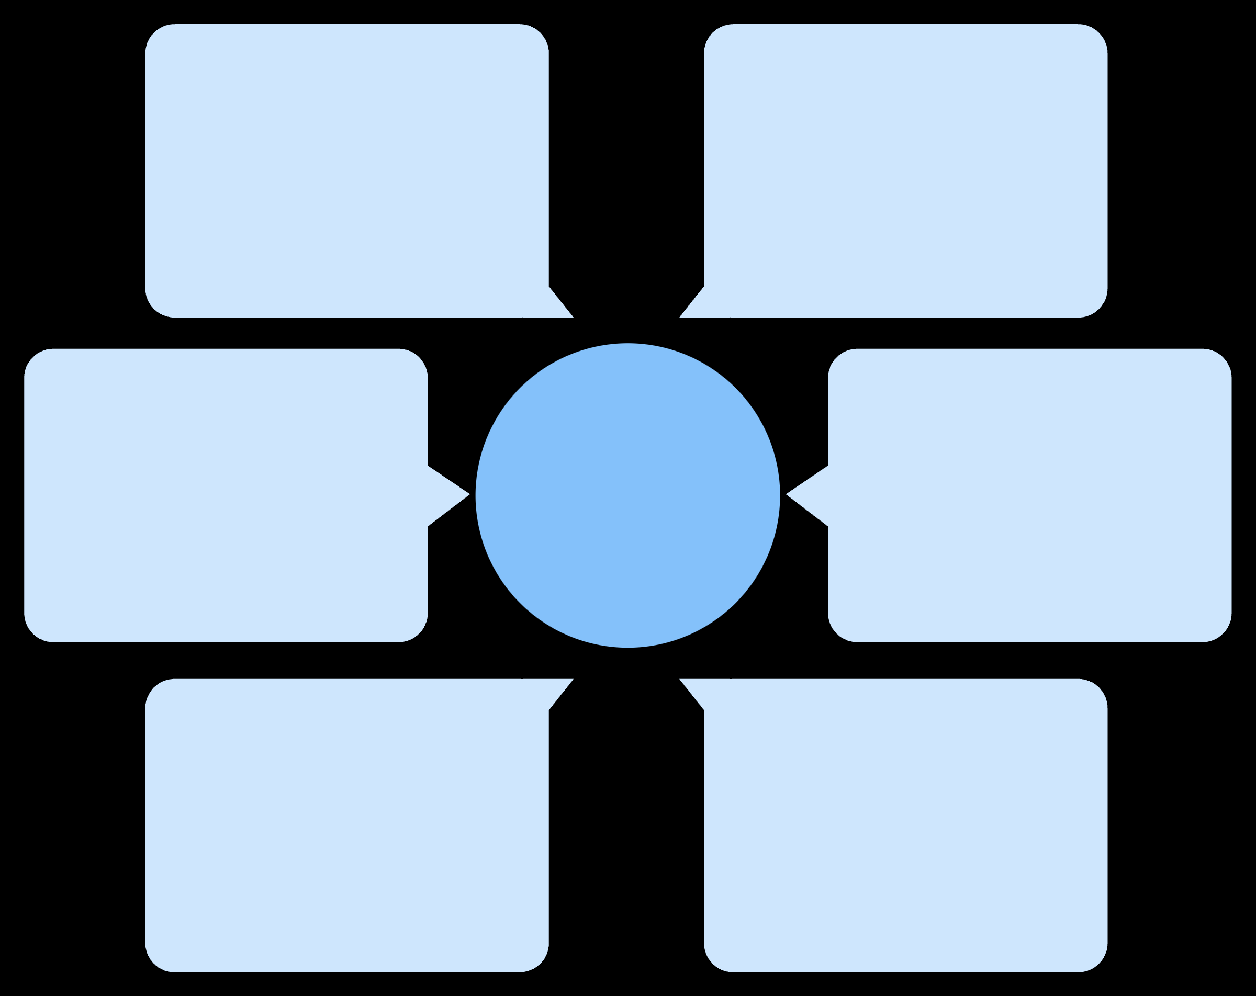
Architecture Overview
Bucket Policies
Static Website (S3)
Access control for both buckets
elevatelab1 hosts UI
KM Mini Drive Architecture
File Storage (S3)
User Access
minigoogledrive stores files
Browse, authenticate, request files
EC2 Application Server
MariaDB on EC2
Stores credentials & metadata
Elastic IP runs app + MariaDB

Slide 5

Features
User authentication
Upload files
Download files
(Login & Signup) powered by MariaDB.
to minigoogledrive.
from minigoogledrive.
Delete files
Share files
Search functionality
securely.
with generated links.
by file name.
Static website
hosted in elevatelab1.

Slide 6
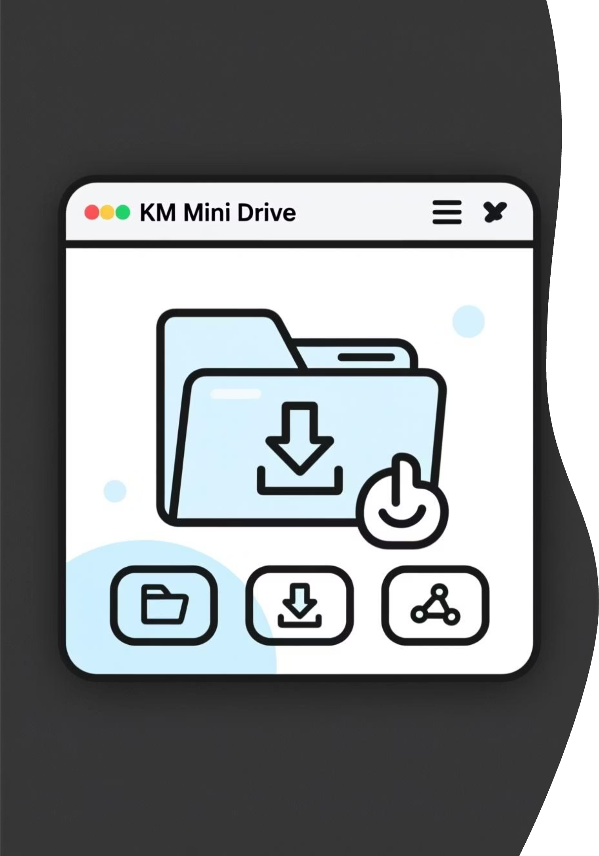
Application Demonstration
KM Mini Drive has been successfully deployed and tested.
The application supports Login, Upload, Download, Delete, and Share operations.
Pictures of the running application are attached as a PDF in the GitHub repository.
These images confirm the functionality and working interface of the project.

Slide 7
Challenges Faced
EC2–S3 connectivity issues.
Bucket policy configuration errors.
File permission troubleshooting.
IAM role setup for uploads.
MariaDB installation and configuration on EC2.

Slide 8
Solutions & Learnings
01
02
03
Debugging step-by-step improved clarity.
Importance of documenting each step (README, screenshots).
Learned how to configure MariaDB for authentication and metadata storage.
04
05
Gained confidence in AWS hosting choices.
Replicated real-world cloud storage workflows.

Slide 9
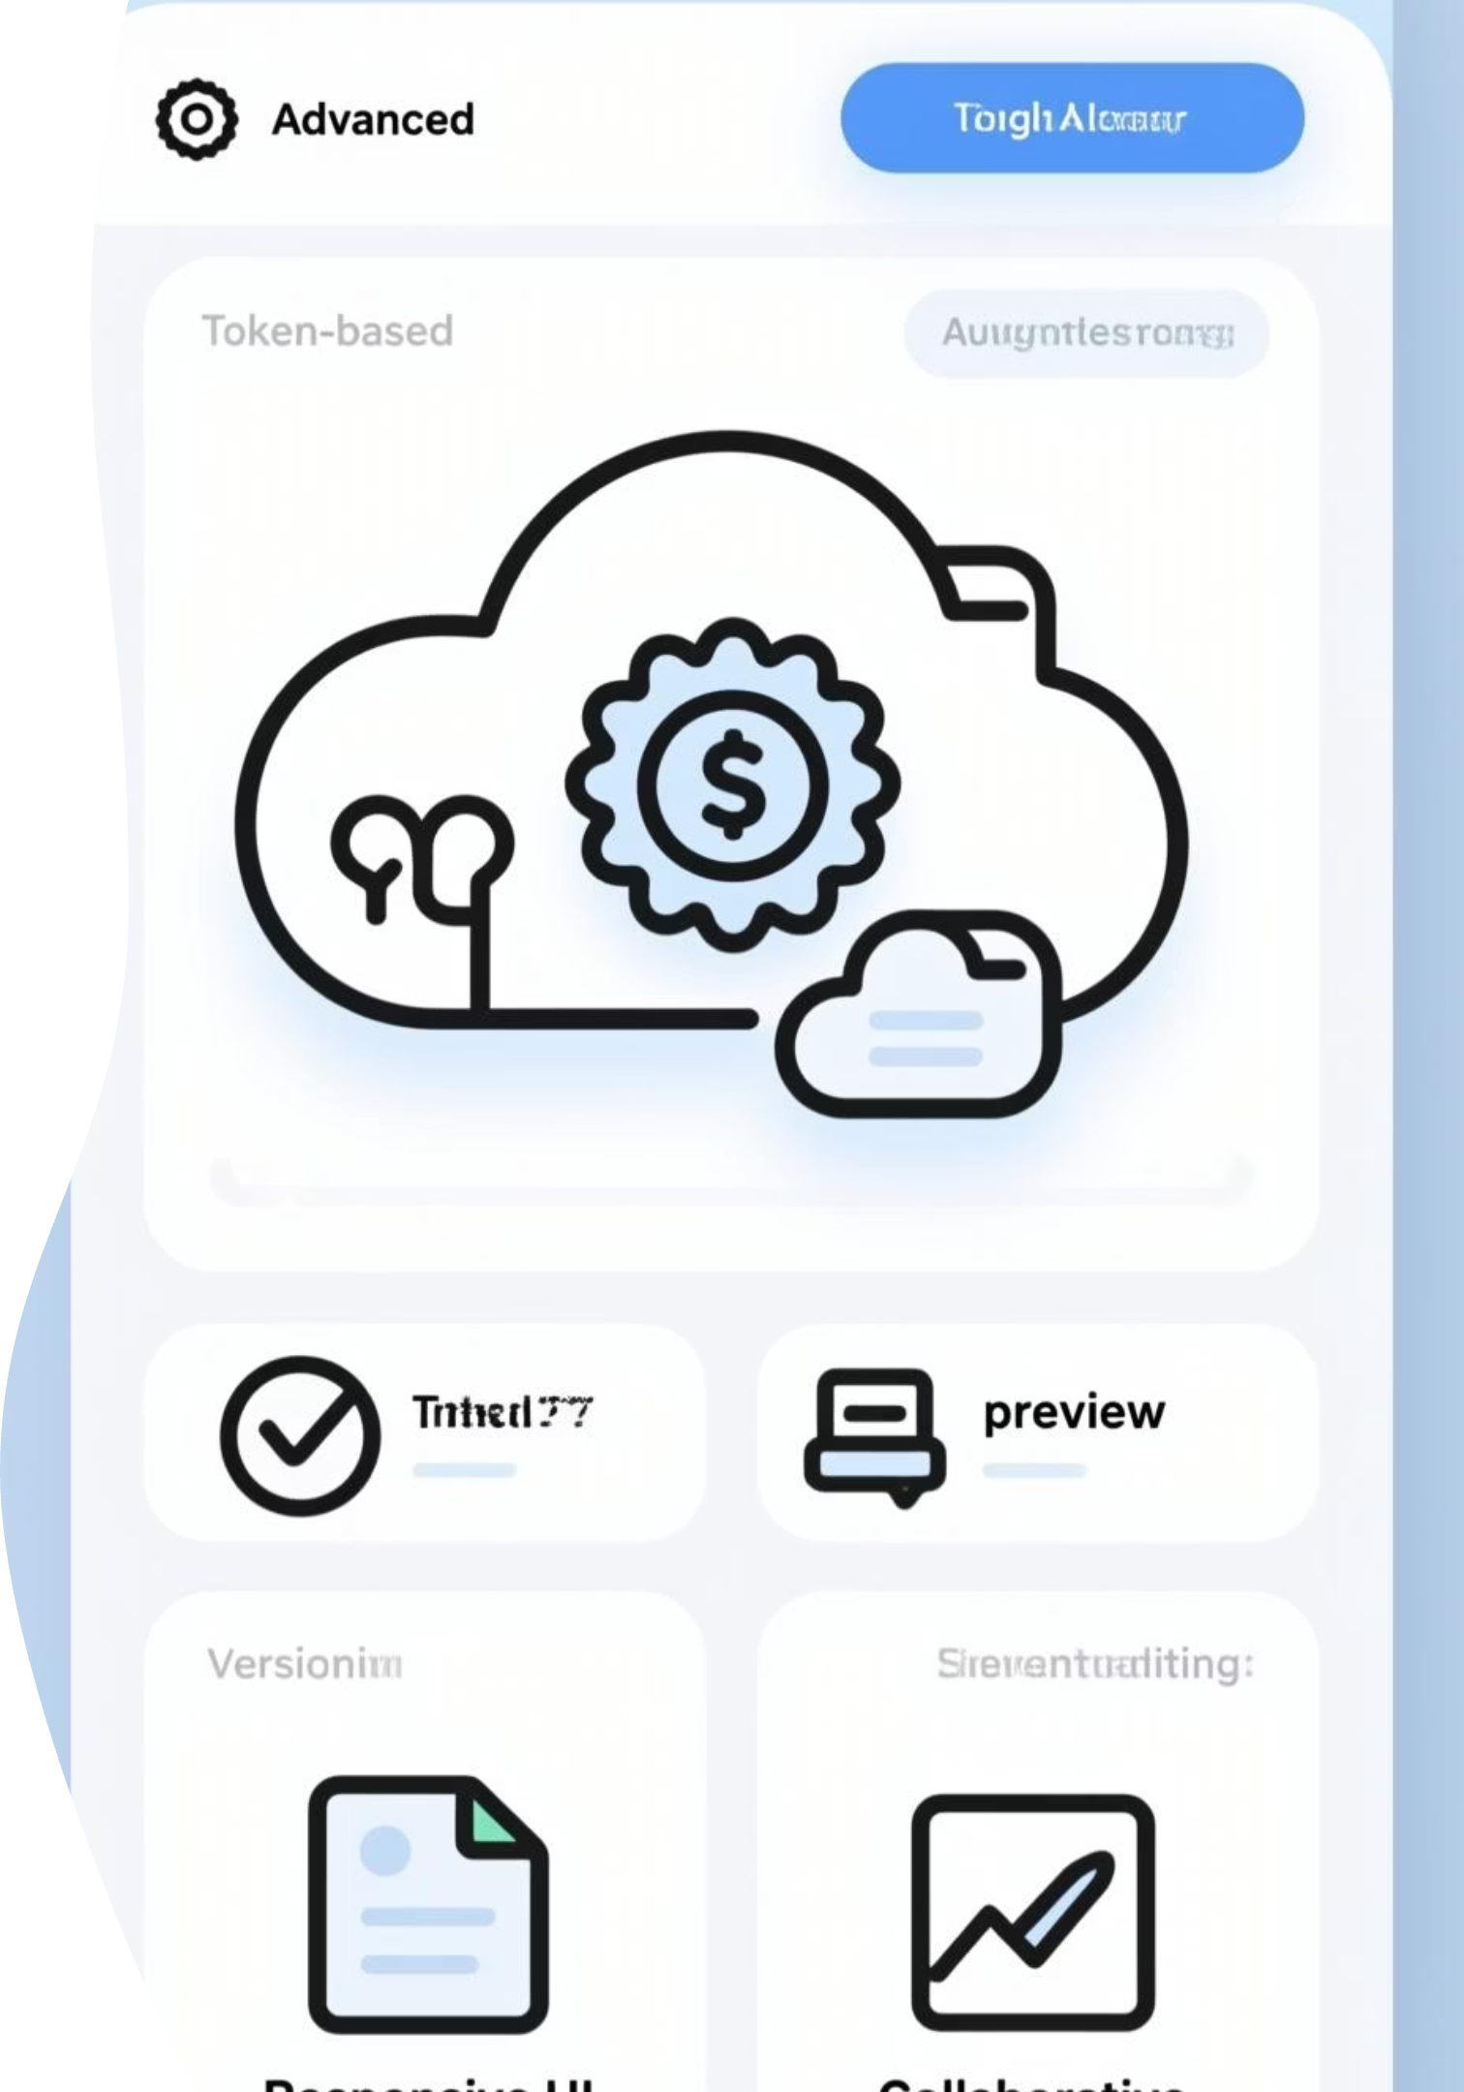
Future Enhancements
Add secure authentication with tokens.
Integrate RDS for scalable metadata tracking.
Improve UI with CSS & responsive design.
Enable collaborative sharing (like Google Docs).
Add file preview & versioning.

Slide 10
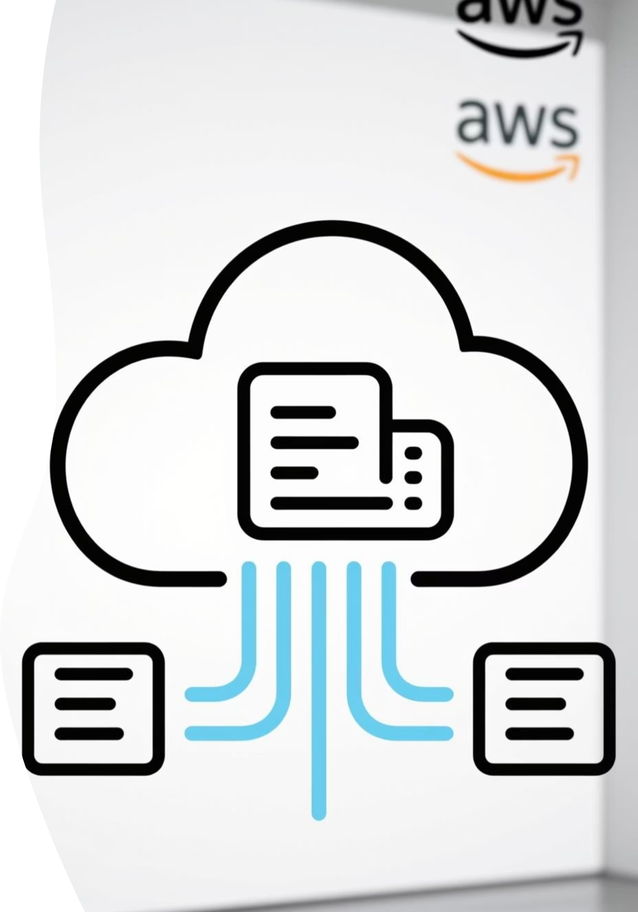
Conclusion
KM Mini Drive successfully replicates Google Drive’s core features.
Strengthened AWS hosting, database, and deployment skills.
Ready to scale into a production-like system with advanced features.

